Slide 1
The black and white SAT problem and relationship with directed graphs
Gábor Kusper
Eszterházy Károly University
Informatics Faculty
Kusper.Gabor@uni-eszterhazy.hu

Slide 2
Motivation
I show a link between directed graphs and propositional logic formulas:
How to transform a directed graph into a SAT problem to check whether the graph is strongly connected or not.
The most prominent graph representations are:
Implication graph.
BDD, Reduced Ordered Binary Decision Diagram.
ZBDD, Zero-Suppressed Binary Decision Diagram.
As we can see a great effort has been done in the direction from formulas to graphs.
Now I study the other way, the direction from graphs to formulas.
Submitted to Theory of Computing.

Slide 3
The SAT problem
Propositional satisfiability is the problem of determining, for a formula of the propositional logic, if there is an assignment of truth values to its variables for which that formula evaluates to be true.
SAT is one of the most-researched NP-complete problems in several fields of computer science, including theoretical computer science, artificial intelligence, hardware design, and formal verification.
By SAT we mean the problem of propositional satisfiability for formulas in conjunctive normal form (CNF).

Slide 4
Representations
CNF: (A or not B or C) and (not A or not B) and (B)
Set based: {{A, not B, C}, {not A, not B}, {B}}
DIMACS:
1 -2 3 0
-1 -2 0
2 0
A solution: B = true, A = false, C = true
Actually, there is no other solution!

Slide 5
The Black-and-White SAT problem
The white assignment assigns to each variable true.
Example: A = true, B = true, C = true
The black assignment assigns to each variable false.
Example: A = false, B = false, C = false
A SAT problem is black-and-white iff it has only two solutions, the white assignment, and the black one.
Example:
-1 2 0
-2 3 0
-3 1 0

Slide 6
Directed graph
a
b
c
D = (V, E) is a directed graph, where
V is the set of vertices, and
E is the set of edges,
edges are ordered pairs of vertices.
Example: V = {a, b, c}, E = {(a,b), (b,c), (c,a)}.
A directed graph is strongly connected iff
there is a path from each vertex to each other vertex.

Slide 7
Communication graph
The directed graph (V, E) is a communication graph iff
for all a in V have that (a, a) is not in E, and
if x is an element of V then not x must not be an element of V.
Example:
a
b
c

Slide 8
A relationship between directed graphs and black-and-white SAT problems.
Let D be a communication graph.
Let SM be the strong model of D.
Let WM be the weak model of D.
Let BB be the Balatonboglár model of D.
Then SM, WM, and BB are
Black-and-White SAT problems iff D is strongly connected.

Slide 9
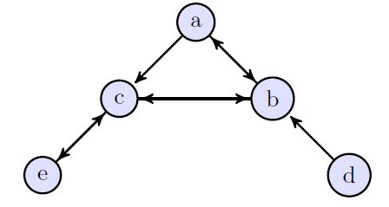
The Strong Model
Let D =(V, E) be a communication graph.
The strong model of D is denoted by SM, and defined as follows:
SM := {{ not a, b } | (a, b) in E} }.
Example:
SM ={{not a, b}, {not a, c}, {not b, a}, {not b, c},
{not c, b}, {not c, e}, {not d, b}, {not e, c}}.
Solutions:
a = b = c = d = e = true
a = b = c = e = true, d = false
a = b = c = d = e = false

Slide 10
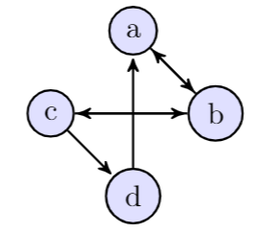
The Weak Model
Let D =(V, E) be a communication graph. The weak model of D is denoted by WM:
OutE(a) := { b | (a, b) in E }.
Cycles := { (a₁, a₂, …, a_{k}) | k=1 or for all i=1..k we have that a_{(i mod k)+1} is in OutE(a_{i}) }.
ExitPonts((a₁, a₂, …, a_{k}) ) := {b | exists i=1..k such that b is in OutE(a_{i})) and not exists j=1..k such taht b = a_{j}) }.
WM := { not C union ExitPonts(C) | C in Cycles and ExitPonts(C) is not empty }.
Example:
Cycles: (a), (b), (c), (d), (a,b), (b,c), (a,b,c,b), (a,b,c,d).
WM = { {not a, b}, {not b, a, c}, {not c, b, d}, {not d, a}, {not a, not b, c}, {not b, not c, a, d}, {not a, not b, not c, d} }.

Slide 11
The BB Model
Let D =(V, E) be a communication graph. The BB model of D is denoted by BM:
NodeRep2 := { {not a, b} | a in V and b = OutE(a) }.
NodeRep3(a) := {not a, b, c}, where a in V and b in OutE(a) and c in OutE(a) and b ≠ c.
NodeRep3 := { NodeRep3(a) | a in V }.
TagForward := { {not a, not b, c} | a in V and b in OutE(a) and c in OutE(b) and a ≠ b ≠ c.
BB := NodeRep2 union NodeRep3 union TagForward.
Example:
BB = {{not a, b}, {not b, a, c}, {not c, b, d}, {not d, a}, {not a, not b, c}, {not b, not c, a}, {not b, not c, d}, {not c, not d, a}, {not d, not a, b}}.

Slide 12
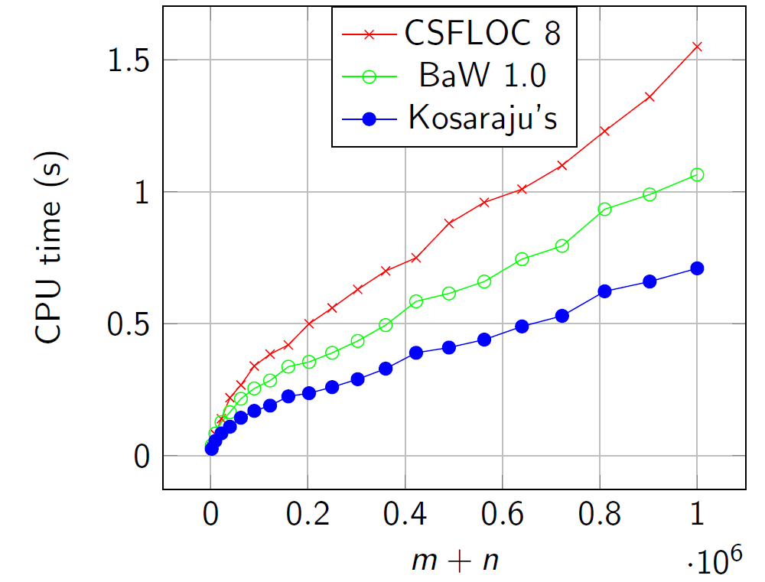
Test results

Slide 13
Thank you for your attention!
Kusper.Gabor@uni-eszterhazy.hu

